Slide 1
Top 100 Tester & Popularity meter features for suppliers
Spotify

Slide 2
Index
Project Overview.
Business understanding.
Data understanding.
Data Modeling.
Expected recommendations.

Slide 3
Project Overview
At the end of each year, Spotify compiles a playlist of the songs streamed most often over the course of that year.
What do these top songs have in common? Why do people like them? What does it take for these songs to become popular?
Our task:
Look for patterns in the audio features of the songs. Why do people stream these songs the most?
Create a Top 100 Tester
Examine popularity meter based on audio features
Notes:
Spotify has revolutionized customer user experiences through predictive analysis. The mobile music industry has transformed from having to purchase a singular song for $1.50 to paying $5 a month for unlimited music. Furthermore, Spotify allows the user to expand and develop their music taste through predictive analytics, which I believe is one of the most significant reasons for their booming success. Based on a single song, they are able to provide daily playlists of hundreds of songs for the user to enjoy, and therefore enhancing their overall experience with custom content. In our project proposal, we will be exploring the aspects of the top 100 charts.

Slide 4
Business Understanding

Slide 5



Business Understanding - Industry
Music streaming industry
Main players are:
Spotify.
Apple Music.
SoundCloud.
Contributed by 75% to the reveunues of the Music industry in 2018.*
*MIDia research 2018

Slide 6



Business Understanding - Company.
Founded in 2006, this Swedish company has become the most popular streaming platform across the world.
In 2017, Spotify has reached 71.1 million subscribers.
Spotify contols nearly 36% of the global market.

Slide 7
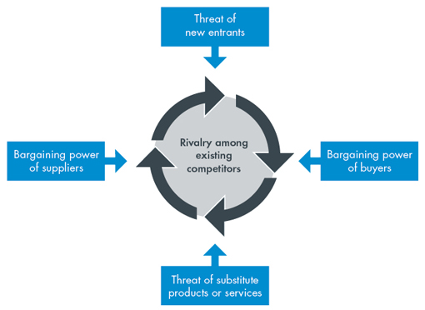
Porter’s Five Forces Framework
Supplier Power: In the music recording industry, the suppliers to the recording companies are the raw materials providers, artists, writers and producers. There is a large pool of talent, which is favorable because it gives the recording companies more negotiating power. It is evident that supplier power is low in the music industry.
Buyer Power: The threat the music recording industry faces from buyers is considered to be relatively high. Overall, buyers have significant power within the music industry as suppliers are forced to offer their products in various channels, especially online. Due to the high buyer power, revenues are decreased, costs are increased, and profits are decreased for the music industry.
Threat of Substitutes: In the current music industry, music streaming services are confronted with various substitute products including physical records, digital media, TV, and radio channels playing 24 hour music, satellite radio, video streaming services, and piracy. The threat of substitutes is high and the industry experiences increased costs, decreased revenues, and decreased profits.

Slide 8
Porter’s Five Forces Framework
Threat of Entry: Independent artists and labels can now offer their products online at very low cost, and are able to skip several steps in the traditional value chain. Due to this change, the Big Three have reacted by building a network of resources and expertise to remain increasingly competitive in the industry. However, low product differentiation and moderate economies of scales still regards the threat of entry for the music industry as high.
Rivalry among existing competitors: There is a small number of large firms (Big Three- Universal, Sony, and Warner) that dominate the industry, and sales for each firm remain relatively high causing increased revenues and profits. However, there is low product differentiation because even though each label owns a selection of artists, the genres that they represent are common throughout the industry. Therefore, consumers are not dependent upon any one record company for a particular type of music. Overall, given that the music recording industry is dominated by a few, large competitors, has seen negative growth with increasing competition, and has low product differentiation, intra-industry rivalry is considered to be high.

Slide 9
Firm Description

Slide 10
Firm Description
Universal Music Group is home to the most iconic and influential labels & brands in music. The firm provides recorded music, music publishing, and merchandising services. They develop, manufacture, market, sell, and distribute recorded music through a network of subsidiaries, joint ventures, and licensees. Universal Music Group serves customers worldwide
8319 employees at UMG as of 2018
Global Firm: Australia, Germany, UK, China, Spain
The line of business that is the subject of our analysis is the development and production of music.
Notes:
Major Product or Service Lines: The identification and development of recording artists and songwriters, and the production, distribution and promotion of the most critically acclaimed and commercially successful music
Geographical Footprint: Argentina, Australia, Austria, Belgium, Brazil, Canada, Chile, China, Czech Republic, Denmark, Finland, France, Germany, Greece, Hungary, India, Italy, Ireland, Japan, Korea, Malaysia, Mexico, Netherlands, New Zealand, Nigeria, Norway, Philippines, Poland, Portugal, Romania, Russia, South Africa, Spain, Sweden, Taiwan, Turkey, Thailand, and the United Kingdom

Slide 11
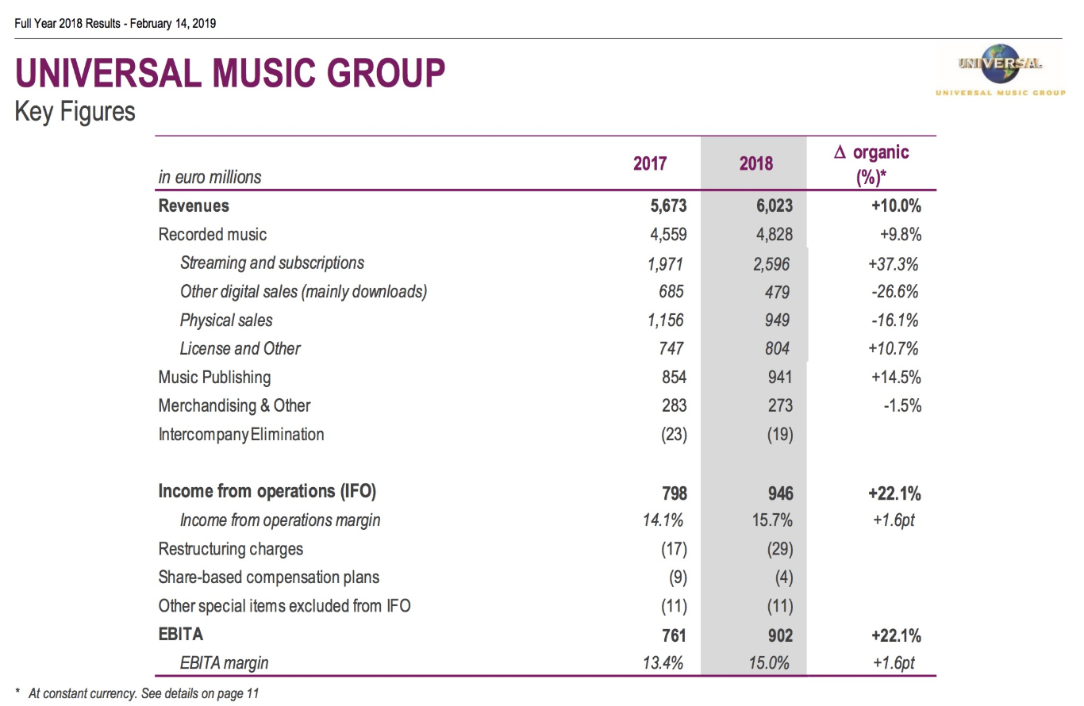
Firm Description
Notes:
Major Product or Service Lines: The identification and development of recording artists and songwriters, and the production, distribution and promotion of the most critically acclaimed and commercially successful music
Geographical Footprint: Argentina, Australia, Austria, Belgium, Brazil, Canada, Chile, China, Czech Republic, Denmark, Finland, France, Germany, Greece, Hungary, India, Italy, Ireland, Japan, Korea, Malaysia, Mexico, Netherlands, New Zealand, Nigeria, Norway, Philippines, Poland, Portugal, Romania, Russia, South Africa, Spain, Sweden, Taiwan, Turkey, Thailand, and the United Kingdom

Slide 12
Firm Description - SWOT Analysis
Strengths | Weaknesses | Opportunities | Threats
Large global and local market Strong Management Brand Recognition Artist Portfolio Large Market Share Influential Celebrity Power Rich History Artist Placement | Piracy File Sharing Technology changing music trends (physical to digital shift) Lack of discovery Uncertainty regarding artist deals Uncertainty with quality of content | Diverse Consumer Base (global market) Innovation Distribution channels New Technologies More fusion of genres Festivals, concerts, events Physical to Digital shift Access to new talent | Intra-Industry Competition Government regulations (copyright laws) Volatile costs Individual artists Music value to consumer (price)
Notes:
Major Product or Service Lines: The identification and development of recording artists and songwriters, and the production, distribution and promotion of the most critically acclaimed and commercially successful music
Geographical Footprint: Argentina, Australia, Austria, Belgium, Brazil, Canada, Chile, China, Czech Republic, Denmark, Finland, France, Germany, Greece, Hungary, India, Italy, Ireland, Japan, Korea, Malaysia, Mexico, Netherlands, New Zealand, Nigeria, Norway, Philippines, Poland, Portugal, Romania, Russia, South Africa, Spain, Sweden, Taiwan, Turkey, Thailand, and the United Kingdom

Slide 13
Data Analysis and Understanding

Slide 14
Data Description
We used the following datasets for this analysis:
Top Spotify Tracks of 2017
Top Spotify Tracks of 2018
19,000 Spotify Songs

Slide 15
Data Description
Audio Features:
song_name, song_popularity, song_duration_ms, acousticness, danceability, energy, instrumentalness, key, liveness, loudness, audio_mode, speechiness, tempo, time_signature, audio_valence
13070 records in our data set
The data collection spanned 1 year
Target Variable: Song Popularity, Top Probability
Notes:
song_name: Name of the song
song_popularity: Target Variable
song_duration_ms: The duration of the track in milliseconds
acousticness: A confidence measure from 0.0 to 1.0 of whether the track is acoustic. 1.0 represents high confidence the track is acoustic.
danceability: Danceability describes how suitable a track is for dancing based on a combination of musical elements including tempo, rhythm stability, beat strength, and overall regularity. A value of 0.0 is least danceable and 1.0 is most danceable.
energy: Energy is a measure from 0.0 to 1.0 and represents a perceptual measure of intensity and activity. Typically, energetic tracks feel fast, loud, and noisy. For example, death metal has high energy, while a Bach prelude scores low on the scale. Perceptual features contributing to this attribute include dynamic range, perceived loudness, timbre, onset rate, and general entropy.
instrumentalness: Predicts whether a track contains no vocals. "Ooh" and "aah" sounds are treated as instrumental in this context. Rap or spoken word tracks are clearly "vocal". The closer the instrumentalness value is to 1.0, the greater likelihood the track contains no vocal content. Values above 0.5 are intended to represent instrumental tracks, but confidence is higher as the value approaches 1.0.
key: The key the track is in. Integers map to pitches using standard Pitch Class notation. E.g. 0 = C, 1 = C♯/D♭, 2 = D, and so on.
liveness: Detects the presence of an audience in the recording. Higher liveness values represent an increased probability that the track was performed live. A value above 0.8 provides strong likelihood that the track is live.
loudness: The overall loudness of a track in decibels (dB). Loudness values are averaged across the entire track and are useful for comparing relative loudness of tracks. Loudness is the quality of a sound that is the primary psychological correlate of physical strength (amplitude). Values typical range between -60 and 0 db.
audio_mode: Audio mode indicates the modality (major or minor) of a track, the type of scale from which its melodic content is derived. Major is represented by 1 and minor is 0.
speechiness: Speechiness detects the presence of spoken words in a track. The more exclusively speech-like the recording (e.g. talk show, audio book, poetry), the closer to 1.0 the attribute value. Values above 0.66 describe tracks that are probably made entirely of spoken words. Values between 0.33 and 0.66 describe tracks that may contain both music and speech, either in sections or layered, including such cases as rap music. Values below 0.33 most likely represent music and other non-speech-like tracks.
tempo: The overall estimated tempo of a track in beats per minute (BPM). In musical terminology, tempo is the speed or pace of a given piece and derives directly from the average beat duration.
time_signature: An estimated overall time signature of a track. The time signature (meter) is a notational convention to specify how many beats are in each bar (or measure).
audio_valence: A measure from 0.0 to 1.0 describing the musical positiveness conveyed by a track. Tracks with high valence sound more positive (e.g. happy, cheerful, euphoric), while tracks with low valence sound more negative (e.g. sad, depressed, angry).

Slide 16
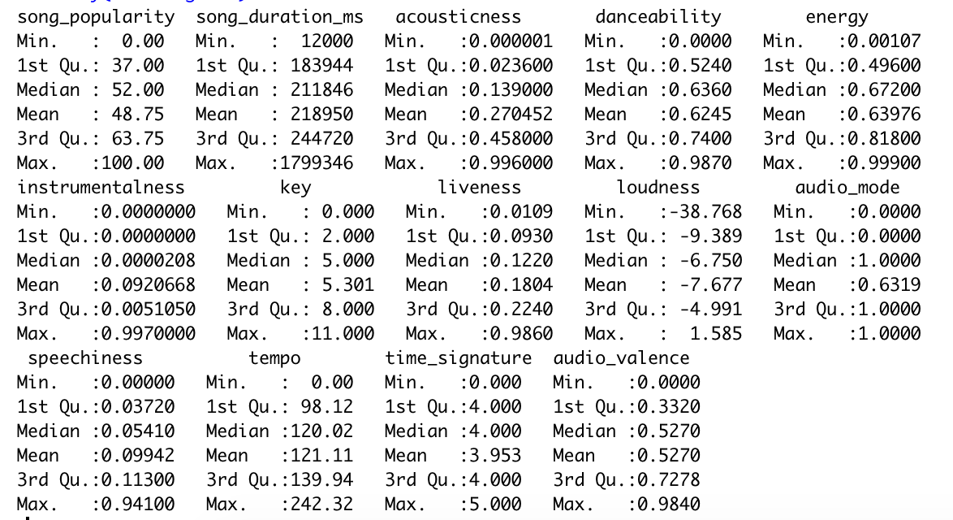
Data Summary

Slide 17
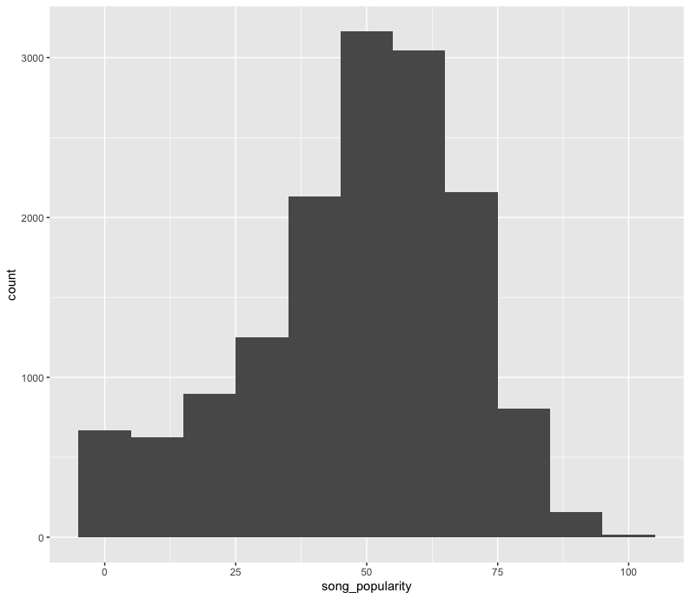
Data Summary

Slide 18
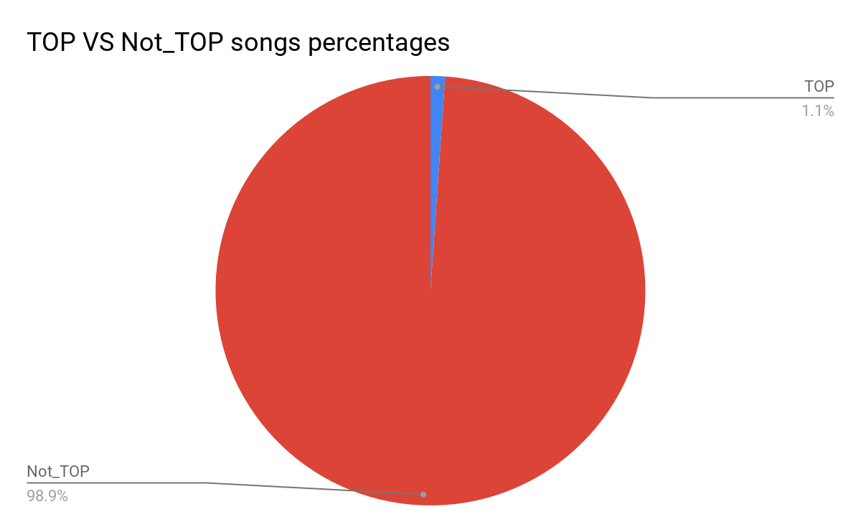
Data overview and challenges.
Data wrangling part:
We put 0 for songs which did not make it to the top 100 list in the last 2 years and 1 for everything else.
As we can find from the chart that positive values in the database is no more than 1.1 % which would indicate that our database is unbalanced.

Slide 19
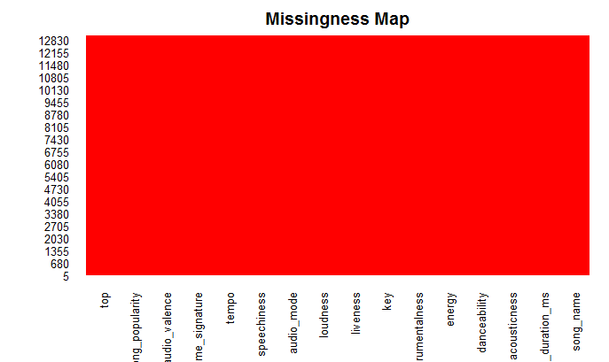
Data cleaning - Missing values
We are lucky that the database has no missing values.
At this stage we will proceed with the next step.

Slide 20
Top Tester

Slide 21
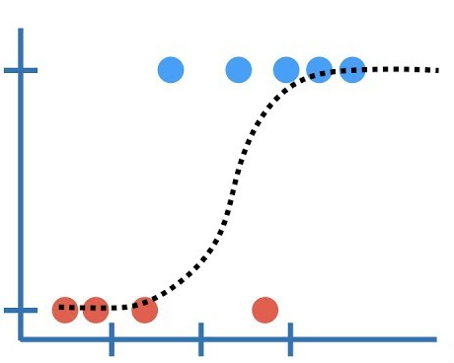
Model selection & challenges.
Choosing model:
As we can see here that the dependant variable which is the “Top probability” is a binomial one, so we chose the logistic regression.

Slide 22
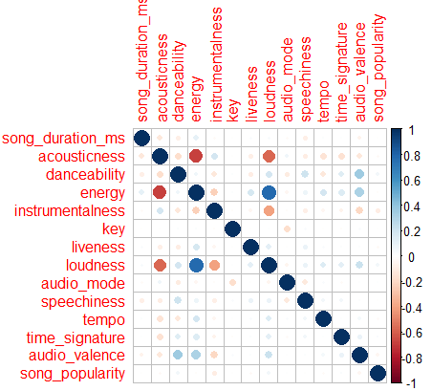
Check for correlated variables
Checking correlated variables before start modeling is important in order to figure out which variables we will eliminate.
We can see that there are correlation between:
Energy, Acousticness and Loudness
Next step, we will check which has the least impact and remove it.

Slide 23
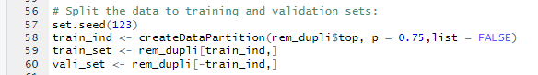
Sampling the data into training and validation sets
We start with setting the seed in order to start with the same sample every run.
Then, we split the data into:
Training set with 75% of the data.
Validation set with 25% of the data.
Note: We split based on the positive values in order to have them well distributed into the two sets.

Slide 24
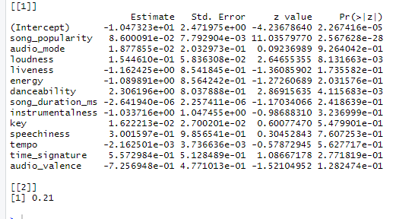
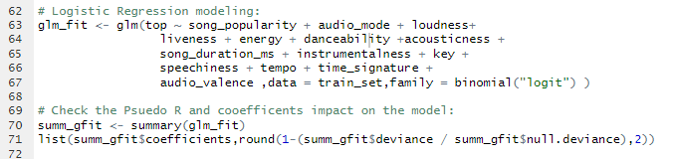
Start modeling and check the Pseudo R square
We choose the uncorrelated independent variables as indicated in the above photo.
After that we list the impact of every independent variable on the model as indicated in the second photo.
Lastly, we checked the Pseudo R square which will explain how much variability is explained with our model which is so little; 21%.
We conclude from here that the model is not stable, but will continue any way.

Slide 25
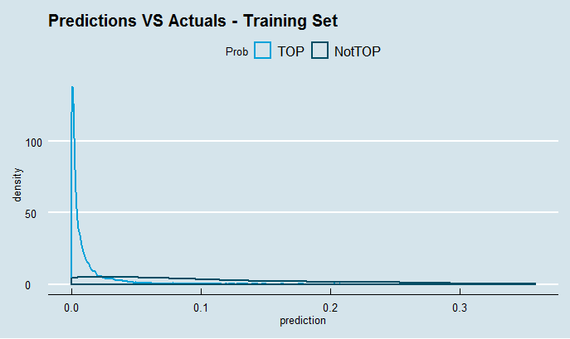
Skewed double density plot indicate that accuracy is not the best way to judge this model

Slide 26
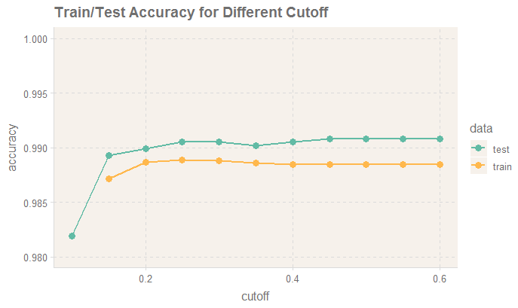
We can find that the best one 0.35

Slide 27
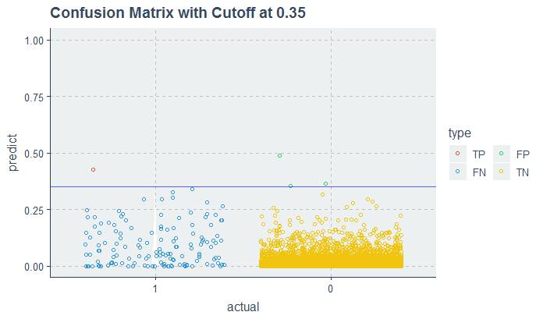
In majority class problems we will find so much FN comparing to TP.

Slide 28
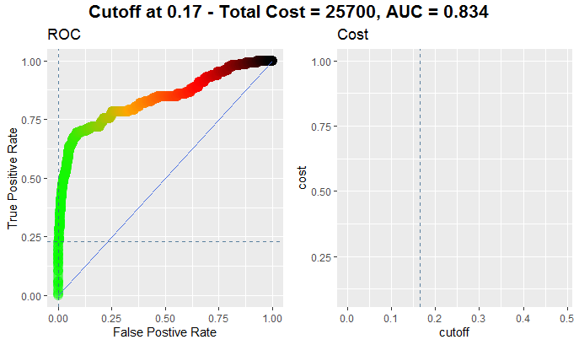
Assigning cost for FP and FN will help getting the best cutoff to improve the model.

Slide 29
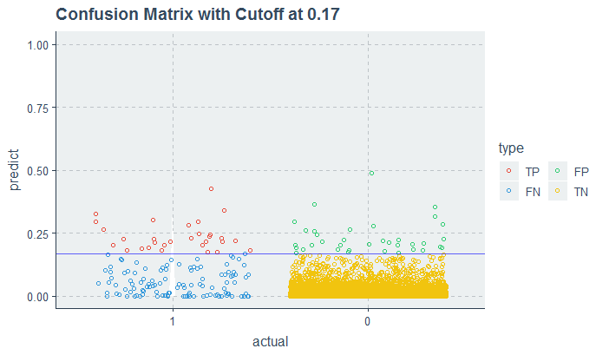
Finally we could improve the number of TP at cutoff of 0.17

Slide 30
Logistics Regression insights and conclusions
Technical insights:
As we saw in the previous slides that we are facing Majority class challenge in our data.
Based on that we figured out that:
Accuracy is not the best indicator to use when judging datasets with majority class issue.
Using LOGIT to model the majority class datasets will return many FN and less TP.
Hence,
Logistic regression is not the best model in case of Majority class datasets, maybe decision trees is a better.
Business recommendations:
Spotify can add “TOP meter” to the songs’ producers’ platform ( “Supplier side” ) in order to help them understand how they can improve their songs’ ranking year over year.
On another hand, Spotify can some sort of early predictions on the top 100 list which will help in:
Contracts negotiations.
Advertisements planning.

Slide 31
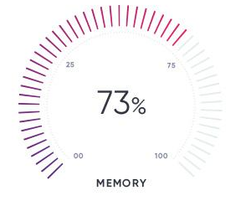
Popularity meter
Popularity

Slide 32
Goals and steps
Opportunity description:
Every single song on Spotify has the following:
Music features ( Danceability, Valence , etc).
Popularity score ( 1:100 ) [ 1 is the least popular ].
Business need:
Business can add “popularity meter” feature to suppliers’ platform in order to follow up on their songs performance.
Technical approach:
As we know that the popularity variable ranges from 1 to 100, hence:
We used linear regression modeling over 14 musical features.
Over the upcoming slides we will remove not useful variable.

Slide 33
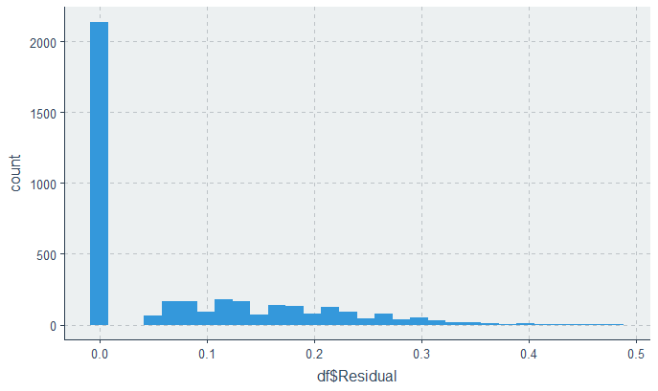
After modeling we could reach over 60% accuracy

Slide 34
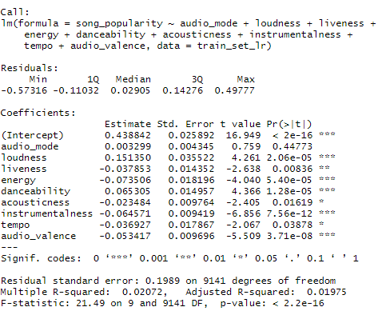
Testing the model and removing unnecessary variables would improve the model.
We started with 14 variables in the model but ended up using only 9 most important with R-square = 20.7

Slide 35
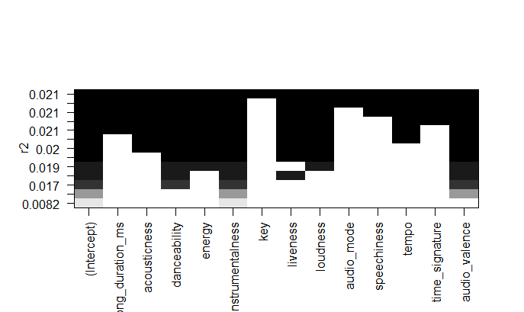
After searching for the best 4 or 5 combinations of predictors we reached this result
Now, we can use only 4 variable to deliver the same or better accuracy for the model.

Slide 36
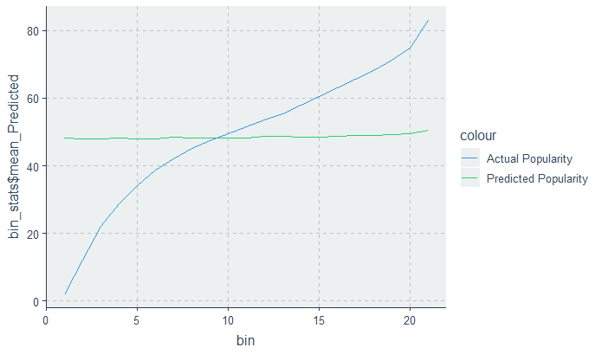
The accuracy is more than 60% but we can improve it by deep diving in feature selection.

Slide 37
Evaluate Model Performance
Logistic Regression: We managed to get better accuracy through choosing the best cutoff value. In the end, we concluded that logistic regression is not the most efficient in a dataset with majority class issues.
Linear Regression: For this type of dataset, a linear regression model would result in the most accuracy. However, in the future, it would be essential to dive in deeper and implement more feature selection.

Slide 38
Recommendations
Using the popularity meter, Universal Music Group implement the meter to improve the ranking of the charts
The Top Tester will help UMG to evaluate their song portfolio in order to know which songs will break the Top 100 charts and try to improve the features as much as they can
When producing and signing new artists, UMG can help structure their songs strategically using predictive analytics to boost the success of the track

Slide 39
References
Rcode.
Datasets.
Research paper.

Slide 40
Thanks….

